Slide 1
Techno Me!
Alissa Carter
Advanced Academic Service/
Instructional Technology Coordinator
Plainview ISD

Slide 2
Microsoft Outlook
View your inbox your way
Multiple email accounts
To Do Bar
Quick Step
Rules
Calendar

Slide 3
Classroom Tools
Class Dojo– ClassDojo is a classroom tool that helps teachers improve behavior in their classrooms quickly and easily. It also captures and generates data on behavior that teachers can share with parents and administrators.
Bouncy Balls uses the increased agitation of multicolored and sized balls to indicate sound level.
Online Stopwatch includes analog and digital timers as well as an egg timer, stopwatch (count up or down), talking clock, metronome, chess clock, an interval timer, and split lap timer. Timers can be displayed full screen and on interactive whiteboards.
Too Noisy App-related noise monitors, o are ideal for small group settings (free one available – too noisy lite online)

Slide 4
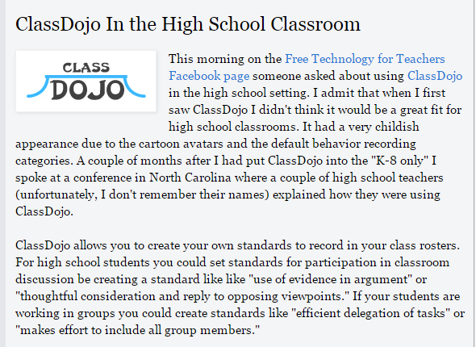
Class Dojo

Slide 5
Class Dojo
Great explanation of ClassDojo Tutorial (video)
How to add behavior standards (video)
ClassDojo and Middle School Students (article)
ClassDojo and High School Students (article)
Lots of Info from the Help Desk of ClassDojo (links)
An Apprehenisive Teacher’s Guide to ClassDojo (article)
Encouraging Active Listening in High School (YouTube)

Slide 6
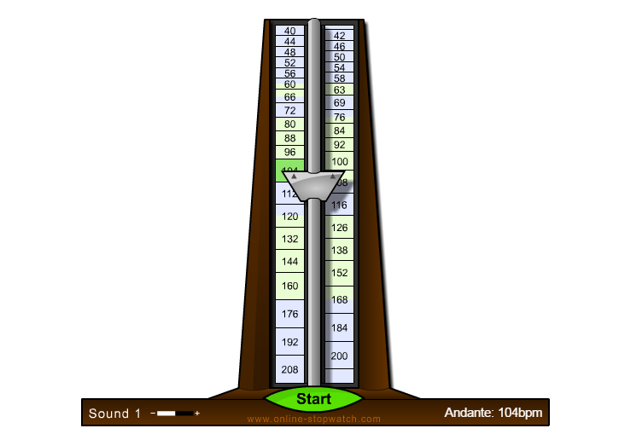
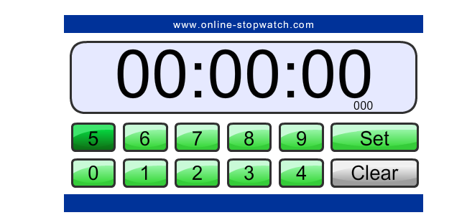
Online Stopwatch
Online Stopwatch includes analog and digital timers as well as an egg timer, stopwatch (count up or down), talking clock, metronome, chess clock, an interval timer, and split lap timer. Timers can be displayed full screen and on interactive whiteboards

Slide 7
Bouncy Balls
Bouncy Balls uses the increased agitation of multicolored and sized balls to indicate sound level.

Slide 8
Too Noisy

Slide 9
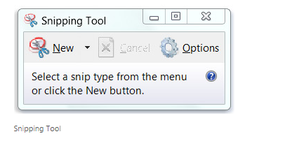
Online Screen Casting/Screen Capture Tools
Clipular (Chrome)
Screencast-O-Matic (not Chromebook)
Screenr (Chrome but not Chromebook)
Clarisketch (ChromeOS only)
Screen-castify (Chrome and ChromeOS)
Clipular
Screen-castify

Slide 10
Assessment Tools
AnswerGarden– A tool for online brainstorming or polling, educators can use this real time tool to see student feedback on questions.
Chatzy (NEW) – Use Chatzy like you would TodaysMeet, to support backchannel conversations in a private setting. These live chats make great companions to classroom discussion, provide exit tickets, or keep a discussion going after the class is over.
Backchannel Chat – Similar to TodaysMeet, this site offers a teacher-moderated version of Twitter. An extension of the in-the-moment conversation might be to capture the chat, create a tag cloud and see what surfaces as a focus of the conversation.
Kahoot – A game-based classroom response system, where teachers can create quizzes using Internet content
Plickers – Allows teachers to collect real-time formative assessment data without the need for student devices. Perfect for the one-device
TodaysMeet– This online collaboration tool allows educators to create a “room” in which students can share ideas, answers and thoughts to lectures and lessons. Educators can view student responses in real time for evidence of learning.
More tools @ http://bit.ly/2lhEF7u

Slide 11
Online Presentation Tools
There is so much more than PowerPoint
Animoto (Chrome)
Buncee - .
Emaze
Fotobabble
Google Slides (Chrome)
Haiku Deck (Chrome).
Magisto (Chrome)
MoveNote (Chrome)
Narrable (Chrome)
Photopeach (Chrome)
Pixiclip
Powtoon (Chrome)
Prezi (Chrome)
Slideshare
SlideSnack (Chrome)
silk.co
Tackk (Chrome)
Thinglink
ToonDoo
UTellStory
Voicethread (Chrome)
Zoho Show (Chrome)

